Slide 1

API Test Automation Framework
A robust, scalable framework for REST API testing built with Java, REST Assured, Cucumber, and Maven — designed to eliminate manual effort and deliver reliable, repeatable test coverage.
Presented By: Rajashree Satapathy

Slide 2
PROBLEM STATEMENT
Manual API testing is time-consuming
Difficult to scale for large applications
Prone to human errors
Requires repetitive validation

Slide 3
PROJECT OBJECTIVE
Reusable Framework
Automate REST API Testing
Implement BDD with Cucumber
Scalable & Maintainable
Notes:
Reusable Framework - Build a modular, extensible architecture that can be applied across projects.
Automate REST API Testing - Replace manual validation with programmatic, repeatable API test scenarios.
Implement BDD with Cucumber - Write human-readable feature files that bridge business and technical stakeholders.
Scalable & Maintainable - Design for growth — easy to extend as new endpoints and modules are added.

Slide 4
TECH STACK
Java
REST Assured
Cucumber (BDD)
Maven
Postman
Log4J
Git
Notes:
Reusable Framework
Build a modular, extensible architecture that can be applied across projects.
Automate REST API Testing
Replace manual validation with programmatic, repeatable API test scenarios.
Implement BDD with Cucumber
Write human-readable feature files that bridge business and technical stakeholders.
Scalable & Maintainable
Design for growth — easy to extend as new endpoints and modules are added.
Technology Stack
Java
Core language for test logic and framework structure.
REST Assured
DSL for testing and validating RESTful web services.
Cucumber (BDD)
Translates Gherkin feature files into executable test steps.
Maven
Manages dependencies and orchestrates the build lifecycle.
Postman
Used for API exploration and initial request validation.
Git & Log4J
Version control for collaboration; Log4J for structured test logging.

Slide 5
KEY FEATURES
Dynamic test data generation
API chaining (data flow across requests)
Reusable request builder
BDD-based test scenarios
Assertion-based validations
HTML report generation

Slide 6
API Under Test: Swagger Petstore
The Swagger Petstore API (https://petstore.swagger.io/v2) is a publicly available REST API used as the test target.
It exposes three core modules:
🐾 Pet - Create, update, retrieve, and delete pet records.
🏪 Store - Manage inventory, place orders, and track status.
👤 User - Handle user registration, login, and profile management.

Slide 7
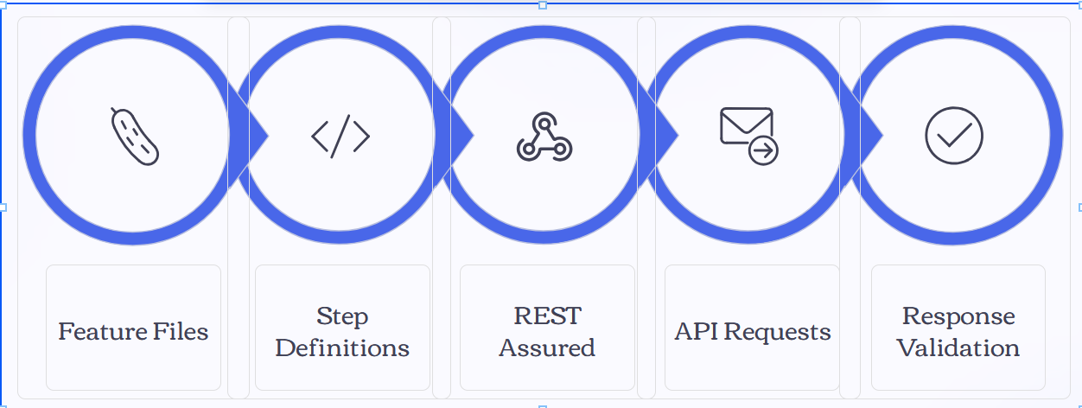
FRAMEWORK ARCHITECTURE

Slide 8
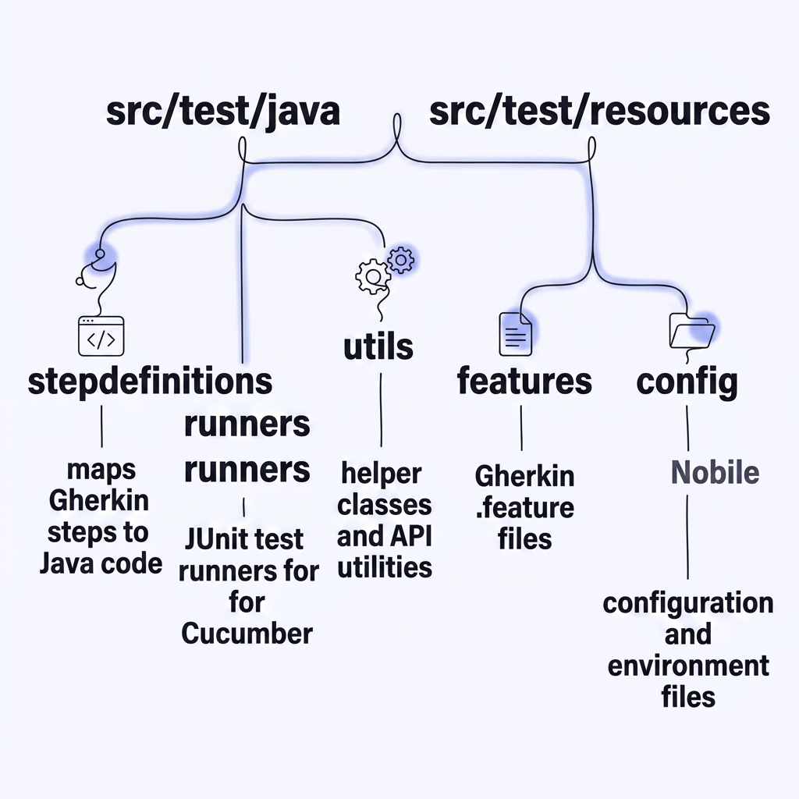
PROJECT STRUCTURE
base → Setup & configuration
hooks → Pre/Post execution
runners → Test execution entry
stepDefinitions → Test logic implementation
utils → Reusable methods
pojo → Data models
features → BDD test scenarios
config → Environment settings
log4j → Logging

Slide 9
Test Cases
Pet Lifecycle (CRUD)
Create → Retrieve → Update → Delete → Validate deletion in a single end-to-end flow.
Inventory Validation
Assert that inventory counts accurately reflect the number of available pets in the store.
User Negative Testing
Cover edge cases: invalid email formats, non-existent users, and failed login attempts.
Cross-Endpoint Validation
Update a pet's status and verify the change propagates correctly to the sold listings.

Slide 10
CHALLENGES & SOLUTIONS
Dynamic Data Across Calls
Resource IDs generated at runtime were stored and passed between steps using Cucumber's shared context.
Integer Overflow on Large IDs
Switched from int to long data types to safely handle large numeric identifiers.
Inconsistent API Responses
Added flexible JSON path assertions and tolerant schema validation to handle response variations.
Data Mismatch Across Endpoints
Implemented cross-reference validation steps to confirm data consistency between modules.

Slide 11
EXECUTION & REPORTING
Execution
Command Used:
mvn clean test
Executes all test scenarios automatically
Generates Cucumber HTML report
Reports
Scenario execution details
Step-by-step results
Pass/Fail status
Execution time

Slide 12
RESULTS
Successfully automated multiple API scenarios
Achieved stable and consistent execution
Improved efficiency compared to manual testing

Slide 13
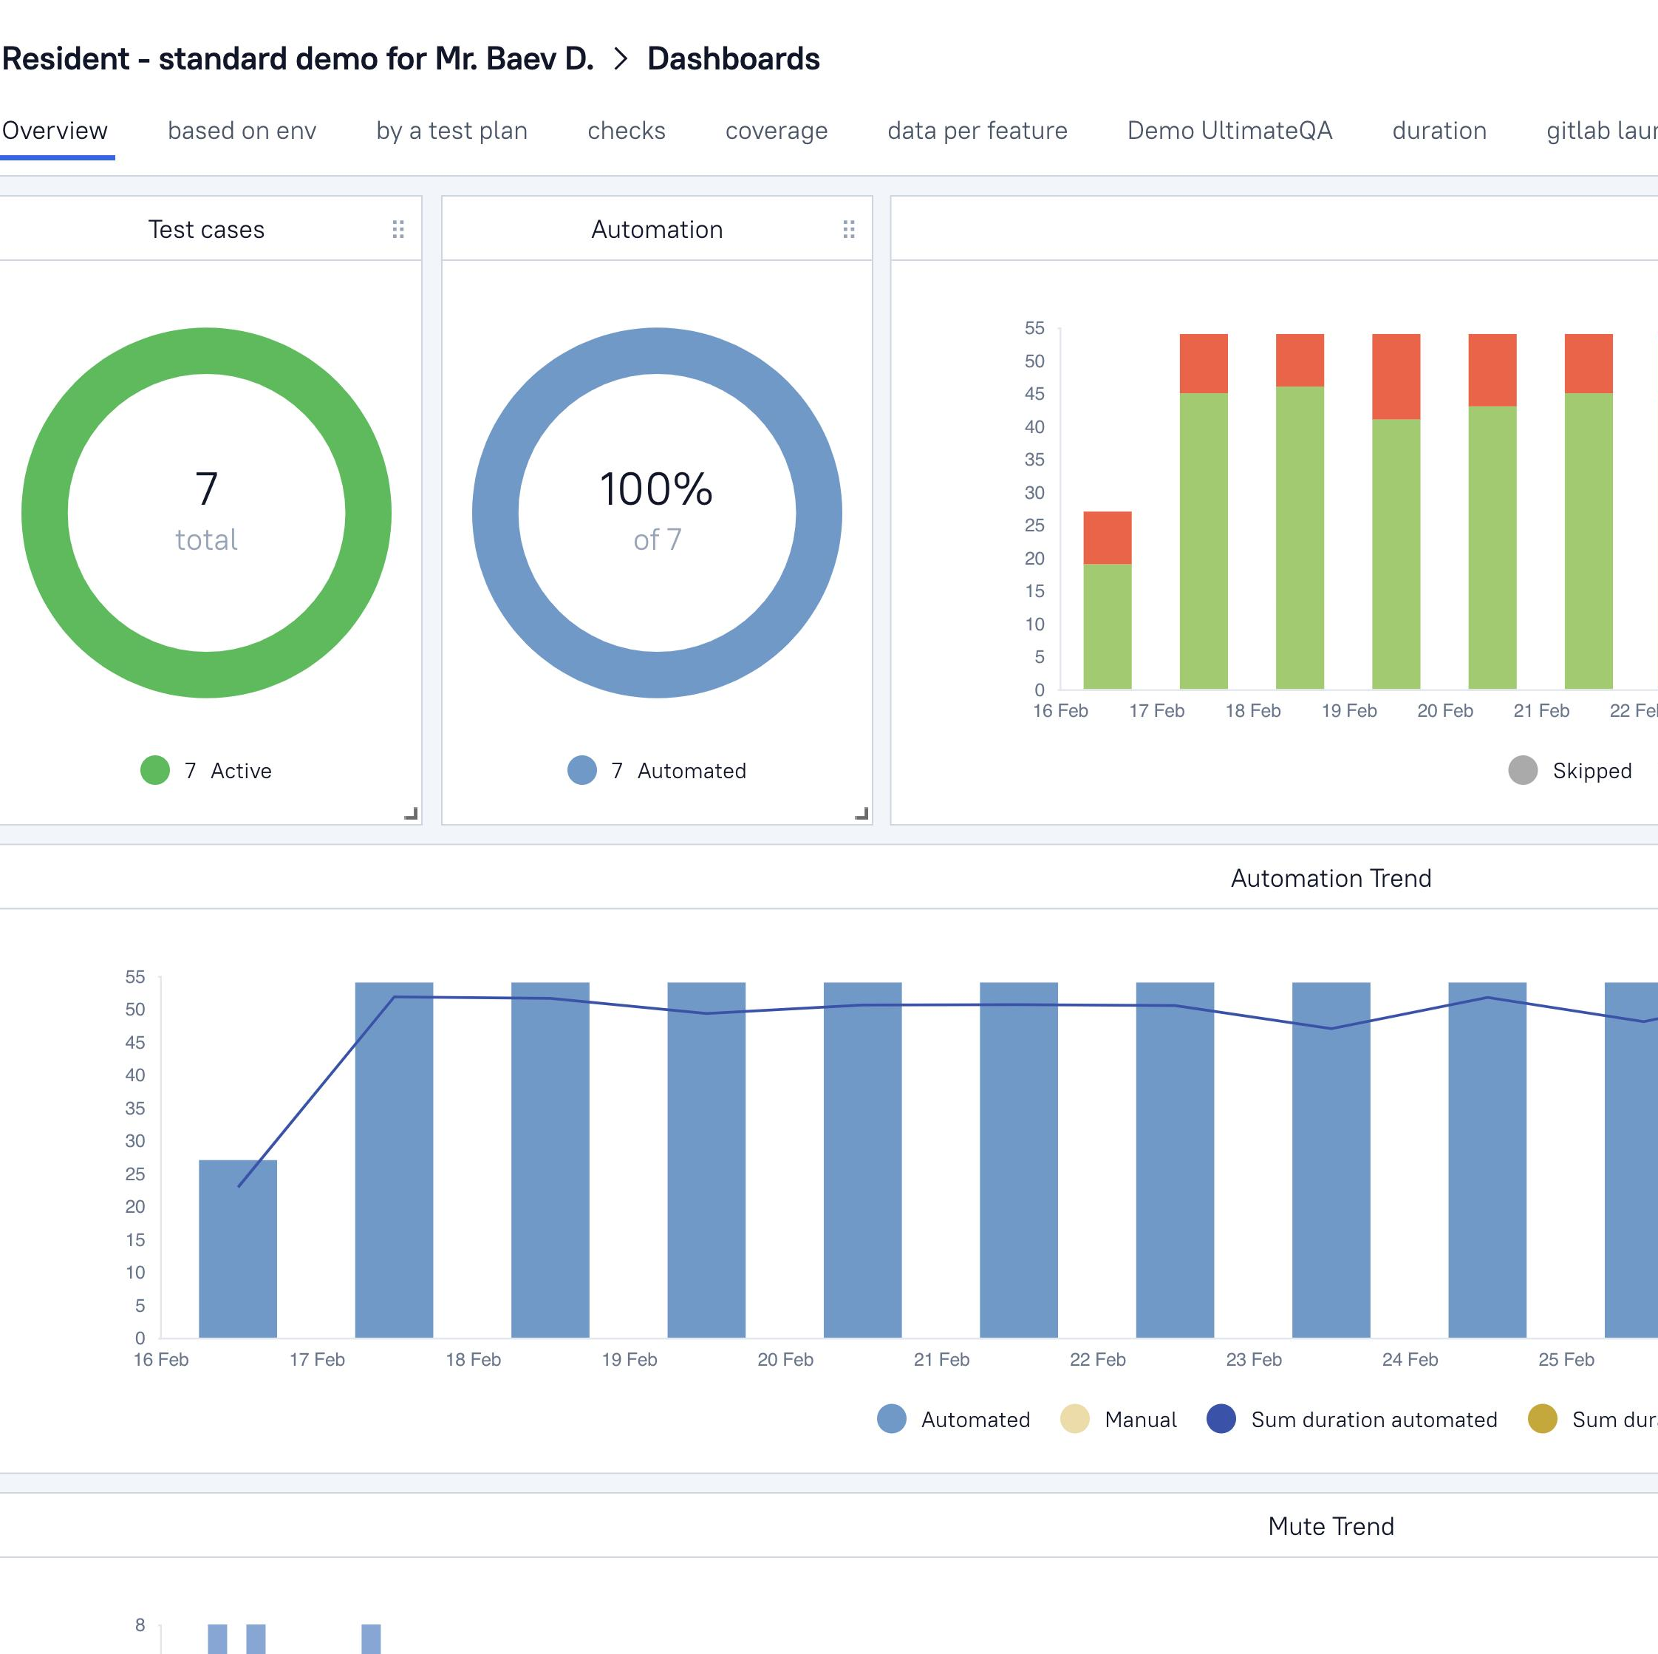
FUTURE ENHANCEMENTS
CI/CD integration (Jenkins)
Parallel test execution
Advanced reporting dashboards
External data-driven testing

Slide 14
CONCLUSION
Built a scalable automation framework
Implemented real-world API testing
Improved debugging and problem-solving skills
Gained hands-on experience with automation tools

Slide 15
Thank you

